Slide 1
Chapter 22
Process-to-Process
Delivery:
UDP and TCP

Slide 2
22.1 Process-to-Process Delivery:
Node-to-Node Delivery:
Delivery of frames between two neighboring nodes over a link by data-link layer.
Host-to-Host Delivery:
Delivery of data-grams between two hosts by network layer.
But communication on Internet is not defined as the exchanged of data between two nodes or between two hosts…
Real communication takes place between two processes (application programs).
But at a single time many processes are running at source and destination.
A mechanism is required to deliver data from one of these processes running on the source host to the corresponding process running on the destination host.
Process-to-Process Delivery:
The transport layer is responsible for process-to-process delivery.

Slide 3
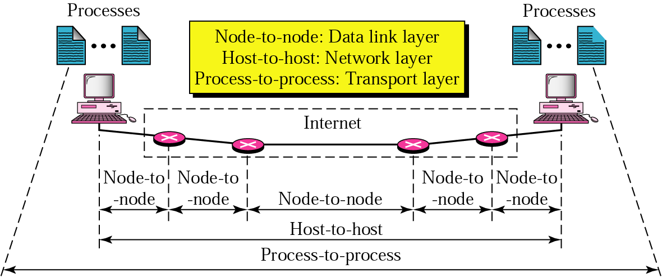
Figure 22.1 Types of data deliveries
Two processes communicate in a client-server relationship.
Fig. 22.1 below shows the three types of deliveries and their domain.
    Node-to-Node Delivery.
    Host-to-Host Delivery.
    Process-to-Process Delivery.

Slide 4
22.1 Process-to-Process Delivery
Client-Server Paradigm
Addressing
Multiplexing and De-multiplexing
Connectionless/Connection-Oriented
Reliable/Unreliable

Slide 5

Note:
The transport layer is responsible for process-to-process delivery.

Slide 6
22.1 Process-to-Process Delivery → Client Server paradigm:
The most common way to achieve process-to-process communication is client-server paradigm.
A process on the local host called a client.
Client needs services from a process usually on the remote host, called a server.
Both processes (client and server) have the same name.
E.g. A Daytime client process: A process to get the day and time from a remote machine.
So we need a client process running on the local host and a Daytime server process running on a remote machine.
Operating systems today support both multi-user and multi-programming environments.
A server and client both can run several programs at the same time.
For communication we must define the following:
    Local host.
    Local process.
    Remote host.
    Remote process.

Slide 7
Aspect | TCP | IP
Purpose | Ensures reliable communication by managing data packets. | Addresses and routes packets between devices.
Function | Manages connection-oriented communication and guarantees delivery. | Provides logical addressing and packet forwarding.
Layer | Transport Layer (Layer 4 in the OSI model). | Network Layer (Layer 3 in the OSI model).
Reliability | Ensures data is received without errors and in order. | Unreliable; does not ensure delivery or order of packets.
Connection | Requires a connection (e.g., handshake before communication). | Connectionless; sends packets without setup.
Error Handling | Handles errors, retransmissions, and flow control. | Relies on upper layers for error detection and handling.
Data Segmentation | Breaks data into segments, reassembles it at the destination. | Splits data into packets for transmission.
Addressing | Uses ports to identify processes or applications. | Uses IP addresses to identify devices.
Examples of Use | File transfers (FTP), web browsing (HTTP/HTTPS), email (SMTP). | Routing data packets across networks.

Slide 8
22.1 Process-to-Process Delivery → Addressing:
An Address is needed when we have to deliver something to one specific destination among many.
E.g. data-link layer needs MAC address to choose ONE node among several nodes if the connection is not point-to-point.
At network layer we need an IP address to choose one host among millions.
At transport layer we need transport-layer address, called port number, to choose among multiple processes running on the destination host.
The destination port number is needed for delivery and the source port number is needed for reply.
In the Internet model, the port numbers are 16-bit integers between 0 and 65,535.
The client program defines itself with a port number, chosen randomly by transport layer software running on the client, called ephemeral (temporary) port number.

Slide 9
22.1 Process-to-Process Delivery → Addressing:
The server process must also define itself with a port number, this port number is however cannot be chosen randomly.
If the computer at the server site runs a server process and assigns a random port number.
The process at the client that wants to access that server and use its services will NOT know the port number.
One solution is that the host send a special packet and request the port number, but this requires more overhead.
The Internet has decided to use universal port numbers for servers, called well-known port numbers.
There are some exceptions to this rule, as there are clients that are assigned well-known port numbers.
Every client process knows the well-known port number of the corresponding server process.

Slide 10
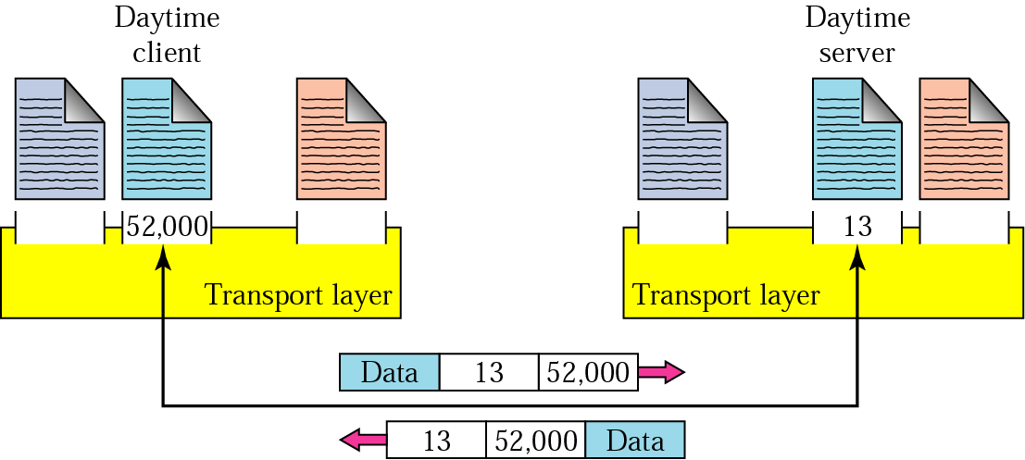
22.1 Process-to-Process Delivery → Addressing:
Figure 22.2 Port numbers
E.g. A Daytime client process, can use an ephemeral (temporary) port number 52,000 to identify itself.
The Daytime server process must use the well-known (permanent) port number 13.
Now the communication is illustrated in Fig. 22.2 below:

Slide 11
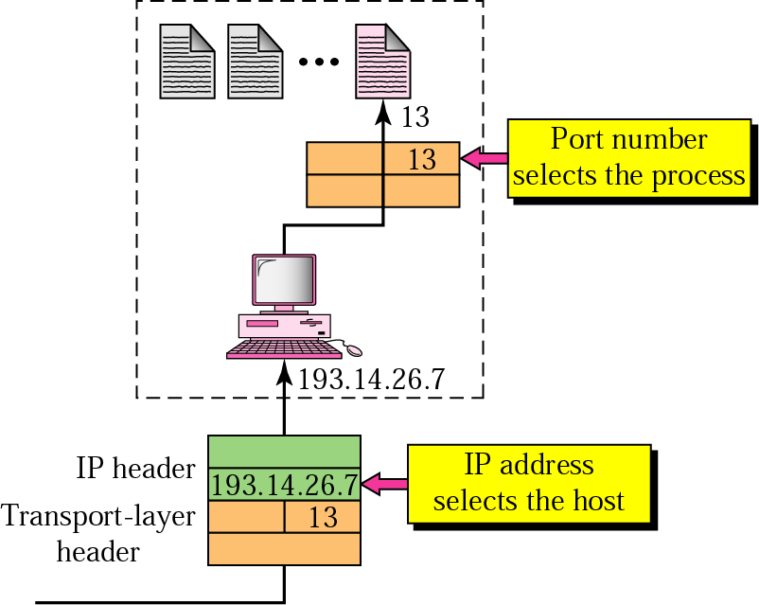
22.1 Process-to-Process Delivery → Addressing:
Figure 22.3 IP addresses versus port numbers
IP address and port number play different roles in selecting the final destination of data.
The destination IP address defines the host among different hosts in the world.
After host has been selected, the port number defines one of the process on this particular host.
As shown in Fig. 22.3 below:

Slide 12
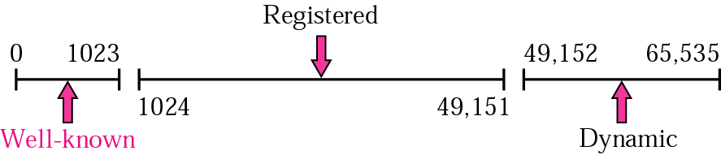
22.1 Process-to-Process Delivery → Addressing:
Figure 22.4 IANA (Internet Assigned Number Authority) ranges
The IANA has divided the port numbers into three ranges, as shown in Fig 22.4 below:
    Well-known ports.
    Registered ports.
    Dynamic ports.
Well-known ports are ranging from 0 to 1023 are assigned and controlled by IANA.
Registered ports are from 1024 to 49,151; are only registered with IANA not assigned and controlled by IANA.
Dynamic ports ranging from 49,152 to 65,535 are neither controlled nor registered.
  Dynamic ports can be used by any process as these are ephemeral ports.

Slide 13
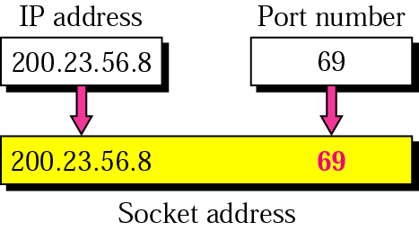
22.1 Process-to-Process Delivery → Addressing:
Figure 22.5 Socket address
At each end to make a connection Process-to-Process delivery needs two identifiers.
    IP address and
    Port number.
The combination of IP address and a port number is called a socket address, as shown in Fig. 22.5 below.
The client socket address defines the client process uniquely .
The server socket address defined the server process uniquely.
A transport –layer protocol needs a pair of socket addresses,
    The client socket address and
    The server socket address.
These for pieces of information are part of the IP header and the transport-layer protocol header.
The IP header contains the IP address, the UDP or TCP header contains the port numbers.

Slide 14
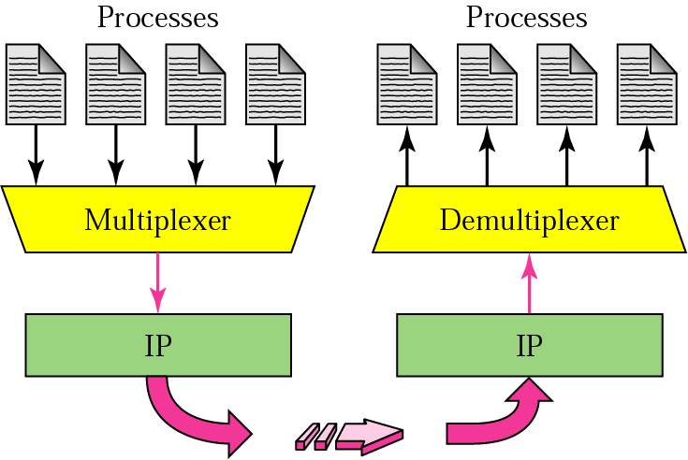
22.1 Process-to-Process Delivery → Multiplexing and De-multiplexing:
Figure 22.6 Multiplexing and de-multiplexing
The addressing mechanism allows multiplexing and de-multiplexing by transport layer as shown in Fig. 22.6 below:

Slide 15
22.1 Process-to-Process Delivery → Multiplexing and De-multiplexing:
Multiplexing:
At the sender site there may be several processes that need to send packets.
However there is only one transport layer protocol (TCP or UDP).
So this many-to-one relationship requires multiplexing.
The protocol accepts messages from different processes, differentiated by their assigned port numbers.
After adding the header, the transport layer passes the packet to the network layer.

Slide 16
22.1 Process-to-Process Delivery → Multiplexing and De-multiplexing:
De-multiplexing:
At the receiver site, the relationship is one-to-many so de-multiplexing is required.
The transport layer receives the data-grams from network layer.
After error checking and dropping of header, the messages are delivered to each intended host based on port numbers by the transport layer.

Slide 17
22.1 Process-to-Process Delivery → Connectionless vs Connection-oriented service:
A transport layer protocol can either be connectionless or connection-oriented.
Connectionless Service:
Packets are sent from one party to another with no need for connection establishment or connection release.
The packets are not numbered means packets can:
    Be delayed
    Lost or
    Arrive out of order.
There is no acknowledgement.
UDP is one of the connectionless protocol on transport layer.

Slide 18
22.1 Process-to-Process Delivery → Connectionless vs Connection-oriented service:
Connection-Oriented Service:
A connection is established between the sender and the receiver.
After the data is transferred, connection is released.
TCP is an connection-oriented protocol at the transport layer.
Connection Establishment:
Connection establishment involves the following steps:
  Host A sends a packet to announce wish for connection establishment and includes its initial information about traffic from A to B.
  Host B sends a packet to acknowledge (confirm) the request of A.
  Host B sends a packet that includes its initialization information about traffic from B to A.
  Host A sends a packet to acknowledge (confirm) the request of B.

Slide 19
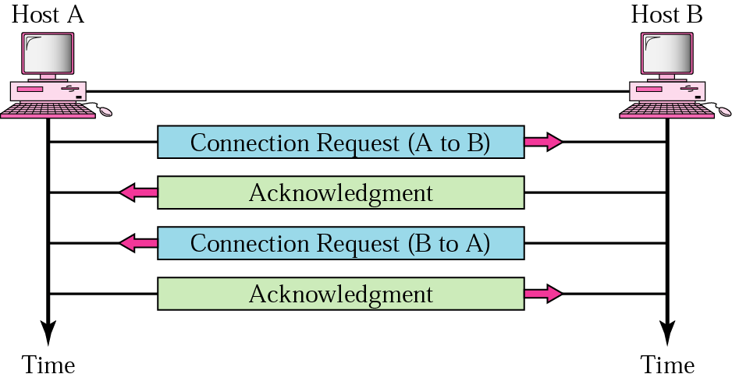
22.1 Process-to-Process Delivery → Connectionless vs Connection-oriented service:
Figure 22.7 Connection establishment
This connection establishment involves 4 steps.
Since step 2 and 3 can occur at the same time, they can be combined into ONE step.
That is host B confirms the request of host A and sends its own request at the same time.
Fig. 22.7 below shows the steps involved in connection establishment.

Slide 20
22.1 Process-to-Process Delivery → Connectionless vs Connection-oriented service:
Connection Establishment Process elaboration:
Each connection request needs to have a sequence number to recover from the loss or duplication of the packet.
  Each acknowledgement needs to have an acknowledgement number as well, for the same reason.
The first sequence number in each direction must be a random for each connection establishment.
  i.e. A sender cannot create several connections that start with the same sequence (e.g. 1)
  The reason is to prevent a situation called playback.
    E.g. in bank transaction a customer makes a connection and requests a transfer of $1 million to a third party.
    If the network somehow duplicates the transaction after the first connection is closed, the bank may assume that there is a new connection and transfer another $1 million to third party.
    This would probably not happen f the protocol required that the sender use a different sequence number each time it made a new connection.
    The bank would recognize a repeated sequence number and know that the request was a duplicate.
Using a sequence number for each connection requires that the receiver keep a history of sequence numbers for each remote host for a specific time.

Slide 21
22.1 Process-to-Process Delivery → Connectionless vs Connection-oriented service:
Connection Termination:
Any of the two parties involved in exchanging data can close the connection.
When connection in one direction is terminated, the other party can continue sending data in the other direction.
So 4-actions are needed to close the connection in both directions:
  Host A sends a packet announcing its wish for connection termination.
  Host B sends segment acknowledgement (confirming) the request of A.
    After this connection is closed in one direction, but not in the other.
    Host B can continue sending data to host A.
  When host B finishes sending its own data, it sends a segment indicate that it wants to close the connection.
  Host A acknowledges (confirms) the request of B.

Slide 22
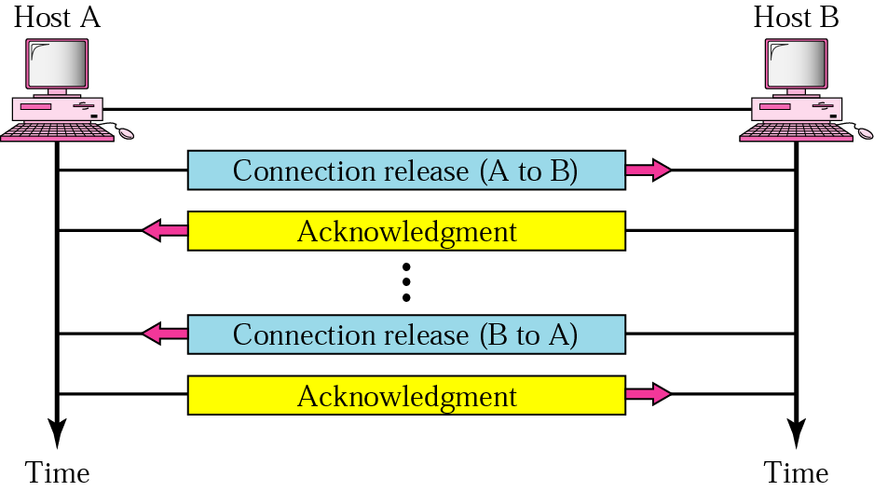
22.1 Process-to-Process Delivery → Connectionless vs Connection-oriented service:
Figure 22.8 Connection termination
The 4-steps connection termination can NOT be reduced to three steps, (as in the case were in connection establishment).
Because the two parties may not wish to terminate at the same time.
So connection termination is asymmetric.
Fig. 22.8 below shows the connection termination process:

Slide 23
22.1 Process-to-Process Delivery → Connectionless vs Connection-oriented service:
How can we make a connection-oriented transport layer over a connectionless network-layer protocol such as IP?
According to the design goal of Internet, the two layers are totally independent.
The transport layer only uses the services of the network layer.
E.g. The post office service is connectionless.
  Each parcel delivered to post office is independent from the next even if we deliver 100 parcels to the same destination.
The post office cannot guarantees that the parcels arrive at the same destination in order even if the parcels are numbered.
But we can create a connection-oriented service on the top of this service.
We can have an agent at the destination city and send the numbered parcels to her.
The agent can keep the parcels until all of them arrived.
Then put them in order and delivered them to the destination.
If a parcel is lost the agent can ask for a duplicate.
We can create a connection to the post office and get her confirmation.
After all parcels have been received, we can call again to announce the disconnection of the service.

Slide 24
22.1 Process-to-Process Delivery → Reliable vs Unreliable:
The transport layer services can be reliable or unreliable.
If the application-layer program needs the reliability, we use a reliable transport-layer protocol by implementing flow and error control at the transport-layer. (e.g. TCP)
  Means a slower and complex service.
If the application program does NOT need reliability, (because it uses its own flow and error control (real-time applications)), then an unreliable protocol can be used. (e.g. UDP)
In the Internet there are two different transport-layer protocols:
TCP: Connection-oriented and reliable.
UDP: connection-less and unreliable.

Slide 25
22.1 Process-to-Process Delivery → Reliable vs Unreliable:
IF the data-link layer is reliable and has flow control and error control, do we need this at the transport layer too?
The answer is YES…
Reliability at the data-link layer is between the two nodes, we need the reliability between the two ends.
Because the network layer in the Internet is unreliable (best-effort-delivery). We need to implement reliability at the transport layer.

Slide 26
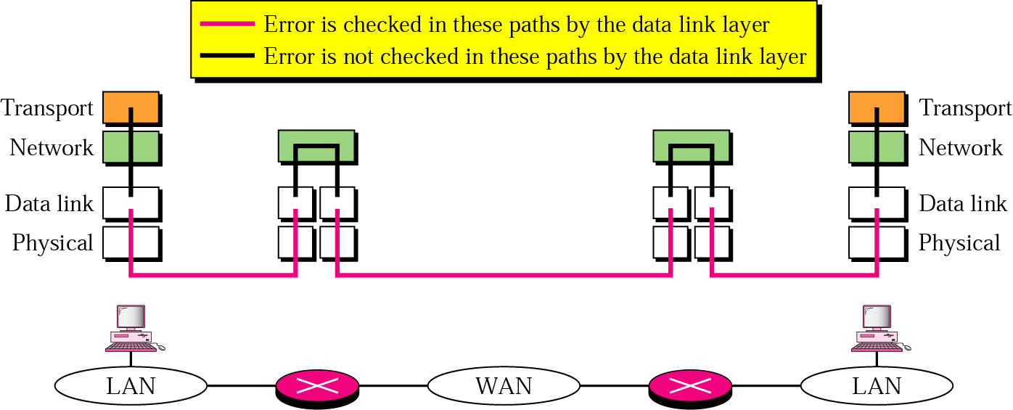
22.1 Process-to-Process Delivery → Reliable vs Unreliable:
Figure 22.9 Error control
Fig. 22.9 below shows that error-control at the data-link layer does not guarantee error control at the transport layer.

Slide 27
22.2 User Datagram Protocol (UDP)
UDP is a simple, connectionless and unreliable transport-layer protocol.
It does not add anything to the services of IP except for providing process-to-process communication. (instead of host-to-host communication).
UDP performs a very limited error checking.
If the UDP is so powerless why would a process wants to use it?
  UDP is a very simple protocol with a minimum of overhead.
  If a process wants to send a small message and does not care much about reliability, it can use UDP.
  It takes much less interaction between sender and receiver.
  UDP is also a convenient protocol for multimedia and multicasting applications.
UDP uses port numbers are the addressing mechanism in the transport layer.

Slide 28
22.2 UDP
Port Numbers
User Datagram
Applications

Slide 29
Note:
UDP is a connectionless, unreliable protocol that has no flow and error control. It uses port numbers to multiplex data from the application layer.

Slide 30
Table 22.1 Well-known ports used by UDP
Port | Protocol | Description
7 | Echo | Echoes a received datagram back to the sender
9 | Discard | Discards any datagram that is received
11 | Users | Active users
13 | Daytime | Returns the date and the time
17 | Quote | Returns a quote of the day
19 | Chargen | Returns a string of characters
53 | Nameserver | Domain Name Service
67 | Bootps | Server port to download bootstrap information
68 | Bootpc | Client port to download bootstrap information
69 | TFTP | Trivial File Transfer Protocol
111 | RPC | Remote Procedure Call
123 | NTP | Network Time Protocol
161 | SNMP | Simple Network Management Protocol
162 | SNMP | Simple Network Management Protocol (trap)

Slide 31
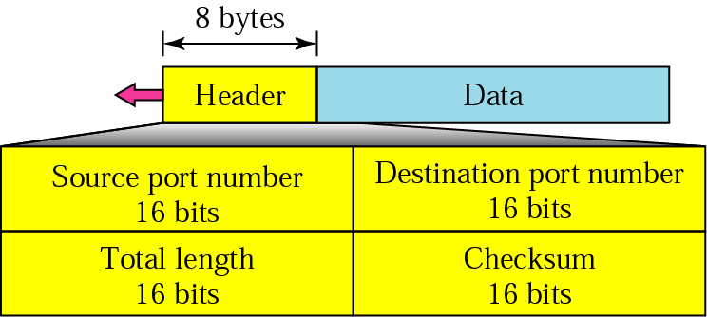
22.2 User Datagram Protocol (UDP) → User Datagram:
Figure 22.10 User datagram format
UDP packet, called user datagram, have a fixed-size header of 8-Bytes.
Fig. 22.10 below shows the format of a user datagram.

Slide 32
22.2 User Datagram Protocol (UDP) → User Datagram → explanation of Fields:
Source Port Number:
16-bitlong field containing the port number used by the process running on the source. (value can be from 0 to 65,535).
Destination Port Number:
16-bits field containing the port number of the process running on the destination.
Length:
16-bit field defines the total length of the user datagram (Header + Data).
Checksum:
Used to detect errors (checksum) over entire datagram. (Header + Data).
Although UDP checksum should be based on the UDP header and payload (data coming from the application layer), but the designers have also added a part of IP header (only those fields not changing by the routers).
This ensure that those fields have not been changed from source to destination.
The calculation of the checksum and its inclusion in a user data-grams optional.
If the checksum is not calculated this field is filled with 0s.

Slide 33
Note:
The calculation of checksum and its inclusion in the user datagram are optional.

Slide 34
22.2 User Datagram Protocol (UDP) → User Datagram → Applications:
UDP is suitable for the process that requires simple request-response communication with little concern for flow and error control.
  It is not usually used for process that needs to send bulk data, such as FTP.
UDP is suitable for process with internal flow and error control mechanisms.
  The trivial File Transport Protocol (TFTP) includes flow and error control.
UDP is a suitable transport protocol for multicasting.
  Multicasting capabilities are embedded in the UDP software but not in TCP software.
UDP is used for some route update protocols such as Routing Information Protocol (RIP).
UDP is used in conjunction with Real Time Transport Protocol (RTP) to provide a transport-layer mechanism for real-time data.
TFTP, or Trivial File Transfer Protocol, is a simple high-level protocol for transferring data servers use to boot diskless workstations, X-terminals, and routers by using User Data Protocol (UDP).
The Real-time Transport Protocol is a network protocol used to deliver streaming audio and video media over the internet, thereby enabling the Voice Over Internet Protocol (VoIP).

Slide 35
Note:
UDP is a convenient transport-layer protocol for applications that provide flow and error control. It is also used by multimedia applications.

Slide 36
22.3 Transmission Control Protocol (TCP):
Transmission Control Protocol (TCP) in the Internet is:
    Reliable but
    Complex.
TCP is called a stream connection-oriented and reliable transmission protocol.
The connection-orientation and reliability features to services of IP.

Slide 37
22.3 TCP
Port Numbers
Services
Sequence Numbers
Segments
Connection
Transition Diagram
Flow and Error Control
Silly Window Syndrome

Slide 38
22.3 Transmission Control Protocol (TCP) → Port Numbers:
Like UDP, TCP uses port numbers as transport layer Address.
If an application can use both UDP and TCP, the same port number is assigned to this application.

Slide 39
Table 22.2 Well-known ports used by TCP
Port | Protocol | Description
7 | Echo | Echoes a received datagram back to the sender
9 | Discard | Discards any datagram that is received
11 | Users | Active users
13 | Daytime | Returns the date and the time
17 | Quote | Returns a quote of the day
19 | Chargen | Returns a string of characters
20 | FTP, Data | File Transfer Protocol (data connection)
21 | FTP, Control | File Transfer Protocol (control connection)
23 | TELNET | Terminal Network
25 | SMTP | Simple Mail Transfer Protocol
53 | DNS | Domain Name Server
67 | BOOTP | Bootstrap Protocol
79 | Finger | Finger
80 | HTTP | Hypertext Transfer Protocol
111 | RPC | Remote Procedure Call

Slide 40
22.3 Transmission Control Protocol (TCP) → Services → Stream Delivery Service
TCP, unlike UDP is a stream-oriented protocol.
  In UDP a process (an application program) sends a chunk of bytes to UDP for delivery.
  UDP adds its own header to this chunk of data, which is then called a user datagram, and delivers it to IP for transmission.
  The process may deliver several chunks of data to UDP, but UDP treats each chunk independently without seeing any connection between them.
While TCP allows the sending process to deliver data as a stream of bytes and the receiving process to obtain data as a stream of bytes.
TCP creates an environment in which the two processes seem to be connected by an imaginary “tube” that carries their data across the Internet.

Slide 41
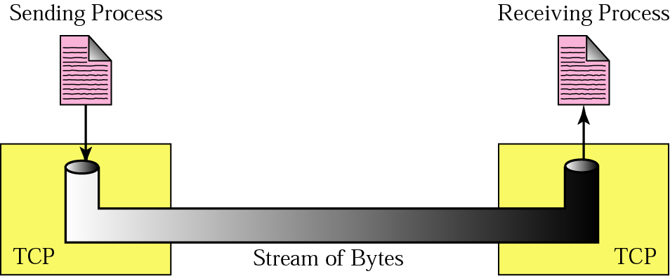
22.3 Transmission Control Protocol (TCP) → Services → Stream Delivery Service
Figure 22.11 Stream delivery
Fig. 22.11 shows the imaginary tube in TCP stream delivery service.

Slide 42
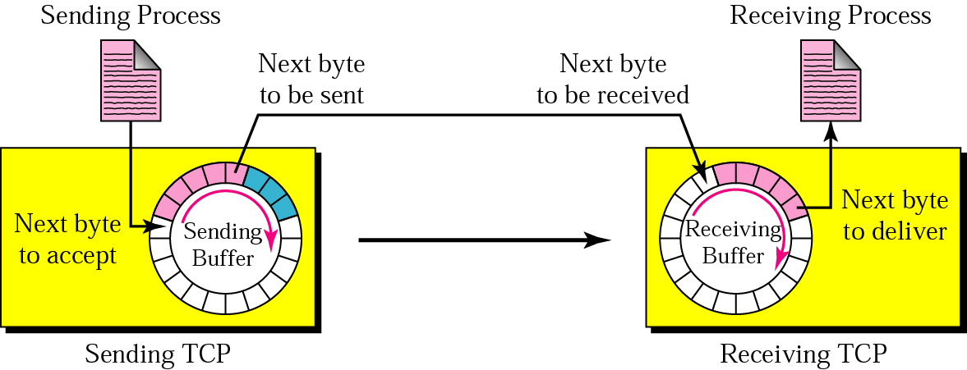
22.3 Transmission Control Protocol (TCP) → Services → Sending and Receiving Buffers:
Figure 22.12 Sending and receiving buffers
Buffers are needed for storage, because the sending and receiving processes may not produce and consume data at the same speed.
There are to buffers, one for each direction:
    The sending buffer and
    The receiving buffer.
One way to implement a buffer is to use a circular array of 1-Byte locations, as shown in Fig. 22.12 below:

Slide 43
22.3 Transmission Control Protocol (TCP) → Services → Sending and Receiving Buffers:
Normally the buffers are hundreds or thousands of Bytes, depending on the implementation.
The Fig.22.11 on previous slide shows the movement of data in one direction.
At sending side, the buffer has three types of locations.
  The white section contains empty locations that can be filled by the sending process (producer).
  The grey area holds Bytes that have been sent but not yet acknowledged. (TCP keeps the Bytes in the buffer until it receives an acknowledgement).
  The colored area are Bytes to be send by sending TCP.
However, TCP may be able to send only part of this colored section, due to the slowness of the receiving process or congestion in the network.
The circular shape is due to the fact that after Bytes in the grey locations are acknowledged, the location is recycled and available for use by sending process.

Slide 44
22.3 Transmission Control Protocol (TCP) → Services → Sending and Receiving Buffers:
The operation of the buffer at the receiver site is simpler.
The circular buffer is divided into two areas (white and colored).
  The white area contains empty locations to be filled by Bytes received from the network.
  The colored sections contain received Bytes that can be consumed by receiving process.
When a Byte is consumed by the receiving process, the location is recycled and added to the pool of empty locations.

Slide 45
22.3 Transmission Control Protocol (TCP) → Services → Bytes and Segments:
Although buffering handles the disparity between the speed of the producing and consuming process, one more step is needed before sending the data.
The IP layer, as service provider for TCP, needs to send data in packets, not as stream of Bytes.
A the transport layer, TCP groups the number of Bytes together into a packet called a segment.
A header is added to each segment for control segment by TCP, and then delivered to IP layer for transmission.
The segments are encapsulated in an IP datagram and transmitted.
The entire operation is transparent to the receiving process.
Fig.22.13 below shows how segments are created from Bytes in the buffers:

Slide 46
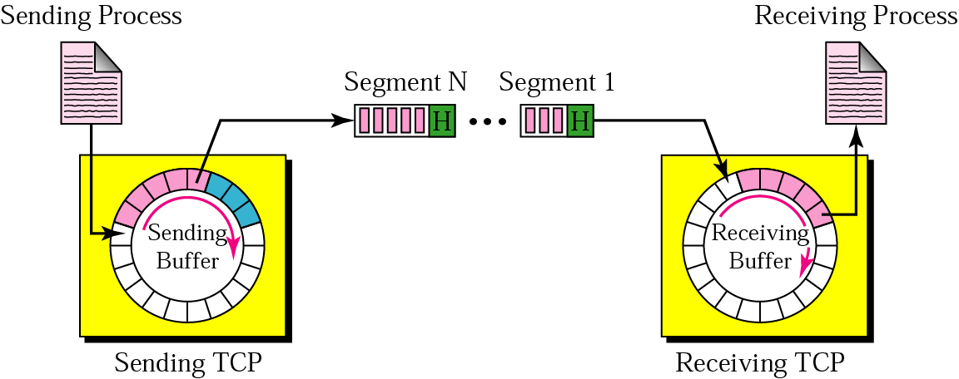
22.3 Transmission Control Protocol (TCP) → Services → Bytes and Segments:
Figure 22.13 TCP segments
Fig.22.13 below shows how segments are created from Bytes in the buffers:
It is noted that segments are not necessarily the same size.
The segments carry hundreds of Bytes. (for simplicity in the below figure only a few Bytes are shown).

Slide 47
22.3 Transmission Control Protocol (TCP) → Services → Full-Duplex Service:
TCP offers full-duplex service, where data can flow in both directions at the same time.
Each TCP then has a sending and receiving buffer, and segments are sent in both directions.

Slide 48
22.3 Transmission Control Protocol (TCP) → Services → Connection-Oriented Service:
As TCP is connection-oriented service, so whenever a process at site A wants to send and receive data from another process at site B, the following occurs:
  A’s TCP informs B’s TCP and gets approval from B’s TCP.
  A’s TCP and B’s TCP exchange data in both directions.
  After both processes have no data left to send and the buffers are empty, the two TCPs destroy their buffers.
The connection is virtual, not the physical.
The TCP segment is encapsulated in an IP datagram and can be sent out of order, or lost, or corrupted and then resent.
Each may use a different path to reach destination.
however, TCP creates a stream-oriented environment in which it accepts the responsibility of delivering the Bytes in order to the other site.
It’s as if a bridge is created that spans multiple islands with traffic going from one island to another on one single connection.

Slide 49
22.3 Transmission Control Protocol (TCP) → Services → Reliable Service:
TCP is a reliable transport protocol.
It uses an acknowledgement mechanism to check the safe and sound arrival of data.

Slide 50
22.3 Transmission Control Protocol (TCP) → Numbering Bytes:
Although TCP software keeps track of the segment being transmitted or received, there is no field for a segment number value.
Instead there are two fields called the :
    Sequence number and
    The acknowledgement number.
These two fields refer to the Byte number, not the segment number.

Slide 51
22.3 Transmission Control Protocol (TCP) → Numbering Bytes → Byte Numbers:
TCP numbers all data Bytes that are transmitted in a connection.
Numbering is independent in each direction.
TCP numbers bytes of data when receives them from the process and stores them in sending buffer.
The numbering does NOT necessarily starts from 0, it starts with a randomly generated number between 0 and 2³²-1.
E.g. if the random number happens to be 1057 and the total data to be sent are 6000Bytes.
The bytes are numbered from 1057 to 7056.
Byte numbering is used for flow and error control.

Slide 52
22.3 Transmission Control Protocol (TCP) → Sequence Numbers:
After Bytes have been numbered, TCP assigns a sequence number to each segment that is being send.
The sequence number for each segment is number of the first bytes carried in the segment.

Slide 53
Note:
The bytes of data being transferred in each connection are numbered by TCP. The numbering starts with a randomly generated number.

Slide 54
Example 1
Imagine a TCP connection is transferring a file of 6000 bytes. The first byte is numbered 10010. What are the sequence numbers for each segment if data are sent in five segments with the first four segments carrying 1000 bytes and the last segment carrying 2000 bytes? 10010 - FIRST BYTE, 10011-SECOND BYTE 10011+998=11009-LAST BYTE (1000)= 11010+999=12009
Solution
The following shows the sequence number for each segment:
Segment 1 ==> sequence number: 10,010 (range: 10,010 to 11,009)
Segment 2 ==> sequence number: 11,010 (range: 11,010 to 12,009)
Segment 3 ==> sequence number: 12,010 (range: 12,010 to 13,009)
Segment 4 ==> sequence number: 13,010 (range: 13,010 to 14,009)
Segment 5 ==> sequence number: 14,010 (range: 14,010 to 16,009)

Slide 55
Note:
The value of the sequence number field in a segment defines the number of the first data byte contained in that segment.

Slide 56
22.3 Transmission Control Protocol (TCP) → Sequence Number → Acknowledgement
Number:
Communication in TCP is full-duplex.
So both sender and receiver can send and receive at the same time.
Each party, numbers the Bytes, usually with a different starting Byte number.
The sequence number in each direction shows the number of first Bytes carried by segment.
Each party also uses an acknowledgement number to confirm the Bytes it has received.
However, the acknowledgement number defines the number of next bytes that party expects to receive.
In addition the acknowledgement number is cumulative, which means:
    The receiver takes the number of the last byte that it has received safe and sound, 1012+1=1013
    Adds 1 to it, and
    Announces this sum as acknowledgment number.
The term cumulative here means if the party uses 5643 as an acknowledgement number,
  It has received all bytes from beginning up to 5642.
  This does not mean that the party has received 5642 bytes because the first byte number does not normally starts from 0.

Slide 57
Note:
The value of the acknowledgment field in a segment defines the number of the next byte a party expects to receive.
The acknowledgment number is cumulative.

Slide 58
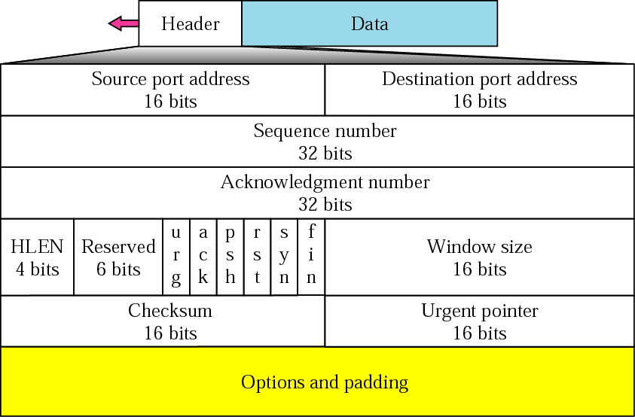
22.3 Transmission Control Protocol (TCP) → Segment:
Figure 22.14 TCP segment format
Segment is the unit of data transfer between two devices using TCP.
The segment consists of 20-60Bytes header, followed by datagram from the application program.
  The header is 20 Bytes if there are no options.
  The header is 60 Bytes if it contains options.
The format of the segment is shown in Fig. 22.14 below:

Slide 59
22.3 Transmission Control Protocol (TCP) → Segment → Header Fields:
Source Port Address:
16-bit field that defines the port number of the application program in the host that is sending the segment.
Destination Port Address:
16-bit field that defines the port number of the application program in the host that is receiving the segment.
Sequence Number:
32-bit field defines the number assigned to the first Byte of data contained in the segment.
Acknowledgement Number:
32-bit field defines the byte number that the sender of the segment is expecting to receive from the other party.
    If the Byte numbered x has been successfully received, x+1 is the acknowledgment number.
Header Length:
4-bit field indicates the number if 4-Byte words in the TCP header.
    The length of the header can be between 20 to 60 Bytes.
    There for the value of the this field can be between 5 (5 x 4 = 20) and 15 (15 x 4 = 60) .

Slide 60
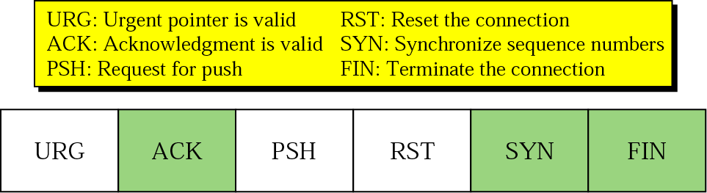
22.3 Transmission Control Protocol (TCP) → Segment → Header Fields:
Figure 22.15 Control field
Reserved:
6-bit field reserved for future use.
Control:
This field defines 6-different control bits or flags, shown in Fig. 22.15 below:
One or more of these bits can be set at a time.
These bits enable:
Flow control,
Connection establishment and termination and
Mode of data transfer in TCP .

Slide 61
Table 22.3 Description of flags in the control field
Flag | Description
URG | The value of the urgent pointer field is valid.
ACK | The value of the acknowledgment field is valid.
PSH | Push the data.
RST | The connection must be reset.
SYN | Synchronize sequence numbers during connection.
FIN | Terminate the connection.

Slide 62
22.3 Transmission Control Protocol (TCP) → Segment → Header Fields:
Window Size:
16-bit field defines the size of the window in Bytes, that the other part must maintain.
    The max size of the window is 65,535, unless the size of the window is augmented by some options field.
Checksum:
16-bit field contains the checksum.
    The calculation of the checksum for TCP follows the same procedure as of UDP.
Urgent Pointer:
16-bit field, which is valid only if the urgent flags is set.
    It is used when segment contains urgent data.
    The number is added to the sequence number to obtain the number of the last urgent Byte in the data section of the segment.
Options:
This field can be up-to 40 Bytes of optional information in TCP header.

Slide 63
22.3 Transmission Control Protocol (TCP) → Connection:
TCP is connection-oriented protocol.
It establishes a virtual path between the source and destination.
All segments belonging to a message are then sent over this virtual path.
Using a single virtual pathway for entire message facilitates the acknowledgement process as well as retransmission of damaged and lost frames.
In TCP, the connection-orientated transmission requires two procedures:
    Connection establishment and
    Connection termination.

Slide 64
22.3 Transmission Control Protocol (TCP) → Connection → Connection Establishment:
TCP is full-duplex communication.
So when two machines in TCP are connected they are able to send segments to each other simultaneously.
This implies that each part must initialize communication and get approval from the other party, before any data transfer.
4-steps are needed for establishment of the connection, as discussed earlier.
However, the second and third steps can be combined to create the three-step connection, called a three-way handshake.

Slide 65
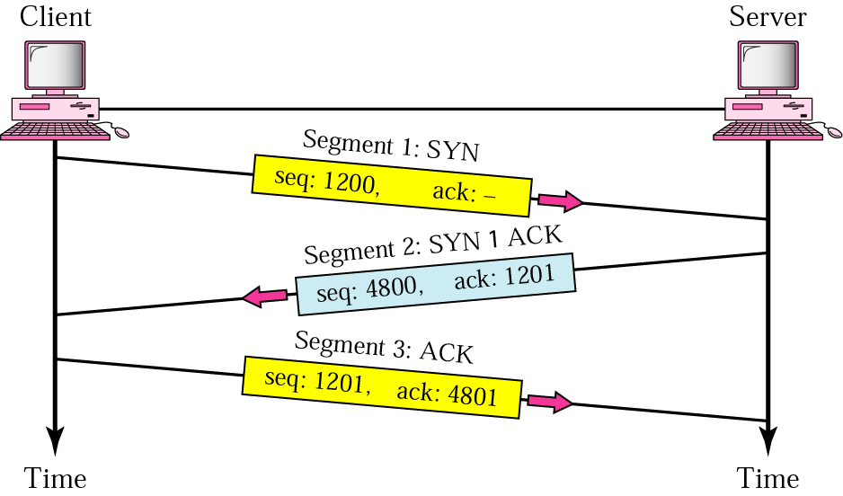
22.3 Transmission Control Protocol (TCP) → Connection → Connection Establishment:
Figure 22.16 Three-step connection establishment
Fig. 22.16 below shows the concept of three-way handshake.

Slide 66
22.3 Transmission Control Protocol (TCP) → Connection → Connection Establishment:
The sequence number is the byte number of the first byte of data in the TCP packet sent (also called a TCP segment). The acknowledgement number is the sequence number of the next byte the receiver expects to receive.
The client sends the first segment, a SYN segment.
The segment includes the source and destination port numbers.
The destination port number clearly defines the server to which the client wants to be connected.
The segment also contains the client initialization sequence number (ISN) used for numbering the bytes of data send from client to the server.

Slide 67
22.3 Transmission Control Protocol (TCP) → Connection → Connection Establishment:
The server sends the second segment, a SYN and an ACK segment.
This segment has a dual purpose.
  First it acknowledges the receipt of the first segment, using the ACK flag and acknowledgement number.
  (it is noted That the acknowledgment number is the client initialization sequence number plus 1., because no user data have been sent in segment 1).
  The server must also defines the client window size.
Secondly the segment is used as the initialization segment for the server.
  It contains the initialization sequence number used the Bytes sent from server to the client.

Slide 68
22.3 Transmission Control Protocol (TCP) → Connection → Connection Establishment:
The client sends the third segment as an ACK segment.
It ACK the receipt of the second segment, using the ACK flag and acknowledgment number field.
It should be noted that the acknowledgment number is the server initialization sequence number plus 1, because no user data have been sent in segment 2.
The client must also defines the server window size.
Data can be sent with the third packet.

Slide 69
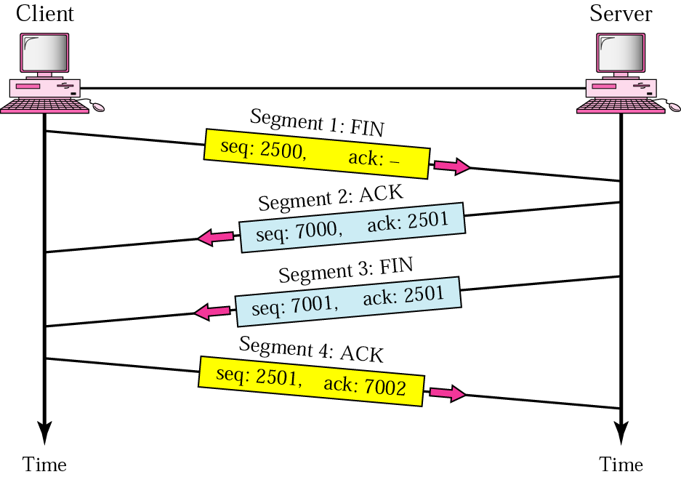
22.3 Transmission Control Protocol (TCP) → Connection → Connection Termination:
Figure 22.17 Four-step connection termination
Any of the two parties involved in data-exchange (client or server) can close the connection.
When connection in one direction is terminated, the other end can continue sending data in the other direction.
Therefore 4-steps are needed to close the connection in both directions as shown in Fig. 22.17 below:

Slide 70
22.3 Transmission Control Protocol (TCP) → Connection → Connection Termination:
The client TCP sends the first segment, a FIN segment.
The server TCP sends the second segment, an ACK segment, to confirm the receipt of the FIN segment from the client.
    It should be noted that the acknowledgment number is 1 plus the sequence number received in the FIN segment because no user data have been sent in segment 1.
The server TCP can continue sending data in the server-client direction.
    When it does not have any more data to send, it sends the third segment as FIN segment.
The client TCP sends the fourth segment, an ACK segment, to confirm the receipt of the FIN segment from TCP server.
    It should be noted that the acknowledgment number is 1 plus the sequence number received in the FIN segment from the server.

Slide 71
22.3 Transmission Control Protocol (TCP) → Connection → Connection Resetting:
TCP may request the resetting of a connection.
Resetting means to destroy the current connection.
This happens in one of three cases below:
The TCP on one side has requested a connection to a non-existent port.
  The TCP on the other side may send a segment with its RST bit set to cancel the request.
One TCP may want to abort the connection due to an abnormal situation.
  It can send an RST segment to close the connection.
The TCP on one side may discover that the TCP on the other side has been idle for a long time.
  It may send an RST segment to destroy the connection.

Slide 72
State transition diagram:
A state transition diagram is used to illustrate the concept.
The states are shown using ovals.
The transition from one state to another is shown using the directed lines.
Each line has two strings, separate by a slash.
    The first show the input, what TCP receives.
    The second is the output, which TCP sends.
Fig. 22.18 in next slide shows the state transition diagram, both for client and server.
The dotted lines represents the server and the solid lines represents the client.
The diagram is more complex than shown here, for simplicity.

Slide 73
Table 22.4 States for TCP
State | Description
CLOSED | There is no connection.
LISTEN | The server is waiting for calls from the client.
SYN-SENT | A connection request is sent; waiting for acknowledgment.
SYN-RCVD | A connection request is received.
ESTABLISHED | Connection is established.
FIN-WAIT-1 | The application has requested the closing of the connection.
FIN-WAIT-2 | The other side has accepted the closing of the connection.
TIME-WAIT | Waiting for retransmitted segments to die.
CLOSE-WAIT | The server is waiting for the application to close.
LAST-ACK | The server is waiting for the last acknowledgment.

Slide 74
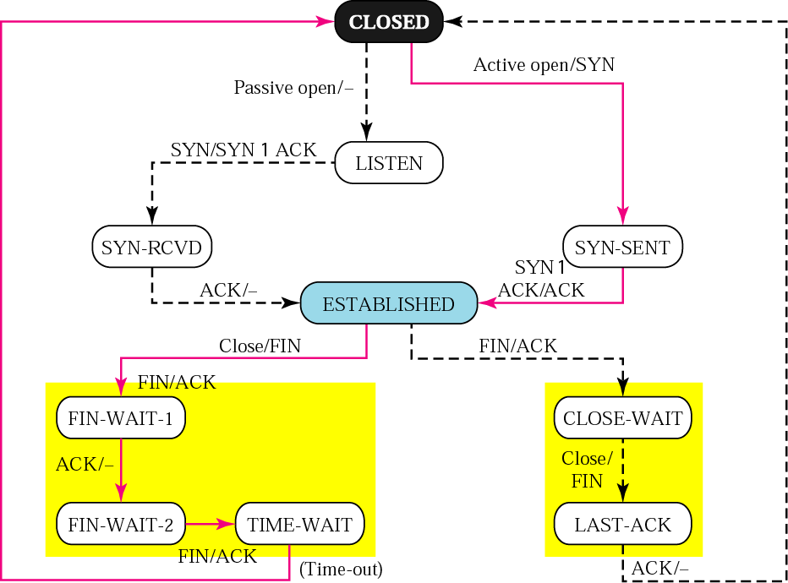
Figure 22.18 State transition diagram
The dotted lines represents the server and the solid lines represents the client.

Slide 75
Client diagram:
The client can be in one of the following states:
CLOSED,
SYN-SENT,
ESTABLISHED,
FIN-WAIT-1,
FIN-WAIT-2 and
TIME-WAIT.
The client TCP starts in the CLOSED state.
While in this state, the client TCP can receive an active open request from the client application program.
  Client sends a SYN segment to server TCP and goes to the SYN-SENT state.
While in this state the client can receive a SYN+ACK segment from the other TCP.
  Client sends an ACK segment to other TCP and goes to the establishment state.
  This is data-transfer state.
  The client remains in this state as long as it is sending and receiving data.

Slide 76
Client diagram:
While in this state the client can receive a close request from the client application program.
  It sends a FIN segment to other TCP and goes to the FIN-WAIT-1 state.
Now client TCP waits to receive an ACK from the server TCP.
  After receiving ACK it goes into the FIN-WAIT-2 state.
  Now the connection is closed in one direction, client now does not send anything.
The client remains in this state waiting for the server to close the connection from the other end.
  If the client receives a FIN segment from the other end, it sends an ACK segment and goes to the TIME-WAIT state.
In this state the client starts a timer and waits until the timer goes off.
  The value of this timer is set to double the lifetime estimate of a segment of maximum size.
  The client remains in this state before totally closing to let all duplicate packets, if any, arrive at their destination to be discarded.
  After the time-out the client goes to the COSED state, from where it had begun.

Slide 77
server diagram:
The server can be in one o the following states:
CLOSED,
LISTEN,
SYN-RCVD,
ESTABLISHED.
CLOSE-WAIT and
LAST-ACK.
The SERVER TCP starts in the CLOSED state.
While in this state, the server TCP can receive a passive open request from the server application program.
  It then goes to the LISTEN state.
While in this state the server can receive a SYN segment from the clinet TCP.
  Server then sends a SYN+ACK segment to the client TCP and goes to the SYN-RCVD state.

Slide 78
server diagram:
While in this state, the server TCP can receive an ACK segment from the client TCP.
  It goes o the ESTABLISHMNET state.
  This is the data transfer state, the server remains in this state as long as it is receiving and sending data.
While in this state, the server TCP can receive a FIN segment form client, which means that the client wished to close connection.
  It can send an ACK segment to the client and goes to the CLOSE-WAIT state.
While in this state the server waits until it receives a close request from the server program.
  It then sends a FIN segment to the client and goes to the LAST-ACK state.
While in this state, the server waits for the last ACK segment.
  It then goes to the CLOSED state.

Slide 79
Flow control:
Flow control defines the amount of data a source can send before receiving an acknowledgement from destination.
In an extreme case the transport-layer protocol can send 1 Byte of data and wait for an acknowledgment before sending the next Byte.
    But this would be extremely slow process.
    If the data are traveling a long distance, the source is idle while it waits for an acknowledgement.
At the other extreme, the transport-layer protocol can send all the data it has without worrying about acknowledgement.
  This speeds up the process but it may overwhelm the receiver.
  Some part of data is lost, duplicated, received out of order, or corrupted, the source will not know until all data have been checked by the destination.
TCP has a solution that sends somewhere in between.
It defines a windows that is imposed on the buffer of data to be delivered from application program and is ready to be send.
TCP sends as many data as are defined by sliding window protocol.

Slide 80
Sliding window protocol:
TCP uses sliding Window Protocol to accomplish flow control.
With this method, both hosts use a window for each connection.
The window spans a portion of buffer containing bytes that a host can send before worrying about an acknowledgement from the other host.
The window is called the sliding window because it can slide over the buffer as data and acknowledgements are sent and received.

Slide 81
Note:
A sliding window is used to make transmission more efficient as well as to control the flow of data so that the destination does not become overwhelmed with data. TCP’s sliding windows are byte-oriented.

Slide 82
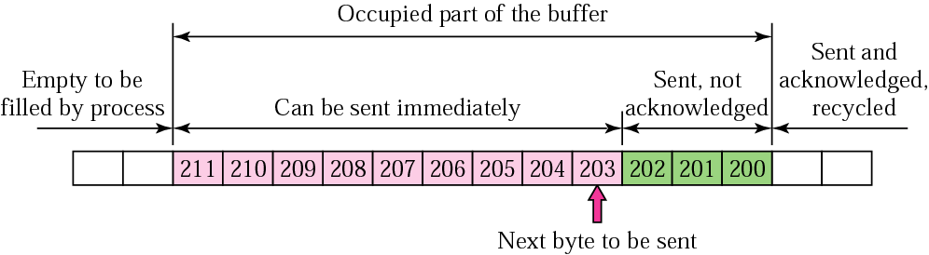
Figure 22.19 Sender buffer
Fig. 22.19 shows the sender buffer.
The Bytes before 200 have been sent and acknowledged so the sender can reuse theses locations.
Bytes 200 to 202 have been sent, but not acknowledged.
The sender has to keep these Bytes in the buffer in case they are lost or damaged.
Bytes 203 to 211 are in the buffer (produced by the process) but have not been sent yet.

Slide 83
Figure 22.19 Sender buffer
If there in no sliding window protocol.
The sender, in that case, go ahead and send all the Bytes (up to 211) in its buffer, without regard to the condition of receiver.
The receiver’s buffer with its limited size, could completely fill-up because the receiving process is not consuming data fast enough.
The excess Bytes discarded by the receiver will require retransmission.
The sender must know about the number of locations available at the receiver site

Slide 84
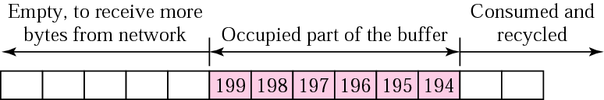
Figure 22.20 Receiver window
Fig 22.20 below shows the receiver buffer.
The next Byte to be consumed by the process is Byte 194.
The receiver expects to receive Byte 200 from the sender (which has been sent but not received).
If the total size of the receiving buffer is N (13) and M (6) locations are already occupied, then N-M (13-6=7) more Bytes can be received.
This value is called the receiver window.
E.g. if N=13 and M=6, this means that the value of the receiver window is 7.

Slide 85
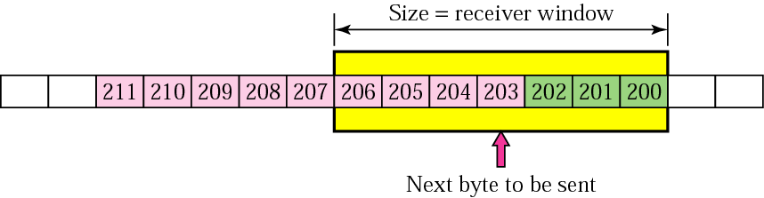
Figure 22.21 Sender buffer and sender window
We have flow control if the sender creates the window, (sender window) with a size less than or equal to the size of the receiver window.
This window includes the Bytes sent and not acknowledged and those that can be sent.
Fig. 22.21 below shows the sender buffer with the sender window:
The size of the window is equal to the size of the receiver window (7 as in example).
The sender can now send only 4 more Bytes as it has sent 3 Bytes already.
Bytes 207 to 211 are in the sending buffer, they also cannot be sent until more news arrives from the receiver.

Slide 86
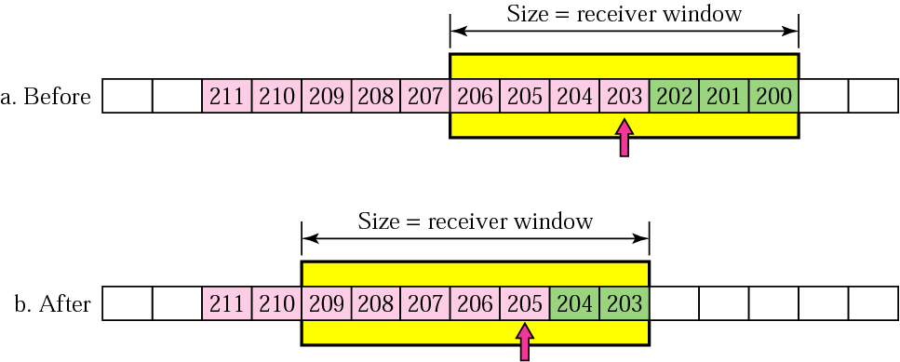
Figure 22.22 Sliding the sender window
Sender has sent 2 more Bytes and an acknowledgement is received from receiver (expecting Byte 203), with no change in the size of the receiver window (still 7).
The sender can now slide its window , and the locations occupied by Bytes 200 to 202 can be recycled.
Fig. 22.22 below shows the position of the sender buffer and sender window before and after this event.
In part b of the Fig. the sender can now send Bytes 205 to 209 (5 more Bytes).

Slide 87
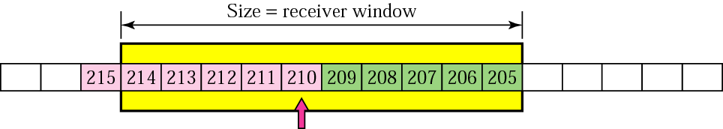
Figure 22.23 Expanding the sender window
If the receiving process consumes data faster then it receives, the size of the receiver window expands (the buffer has more free locations).
The situation can be relayed to the sender, resulting in increase (expansion) of the window size.
Fig. 22.23 below shows that the receiver has acknowledged the receipt of 2 more Bytes (expecting Byte 205) and at the same time has increased the value of the receiver window to 10.
In the meantime, the sending process has created 4 more Bytes and sending TCP has sent 5 more Bytes.

Slide 88
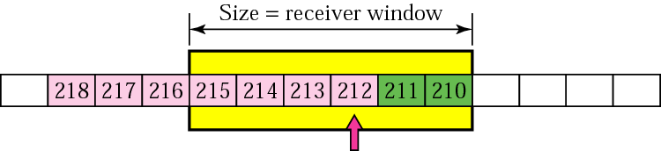
Figure 22.24 Shrinking the sender window
If the receiving process consumes data more slowly than it receives data, the size of the receiver window decreases (shrinks).
In this case the receiver has to inform the sender to shrink its sender window size.
The receiver has received the 5 Bytes (205 to 209).
However the receiving process has to consume only 1 Byte, making the number of free locations reduced to 6 (10-5+1).
It acknowledges Byte 205 to 209 (expecting 210), but also informs the sender to shrink its window size and not to send more than 6 Bytes.
If the sender has already sent 2 more Bytes when it receives the news and has received 3 more Bytes from sending process, we get the window and buffer as shown in Fig. 22.24 below:

Slide 89
Closing the sender window:
What happens if the receiver buffer is totally full?
In this case, the receiver window value is zero.
When this is relayed to the sender, the sender closes it window (left and right walls overlap).
The sender cannot send any Byte until the receiver announces a non-zero receiver window value.

Slide 90
Note:
In TCP, the sender window size is totally controlled by the receiver window value (the number of empty locations in the receiver buffer). However, the actual window size can be smaller if there is congestion in the network.

Slide 91
Note:
Some points about TCP’s sliding windows:
The source does not have to send a full
window’s worth of data.
The size of the window can be increased or
decreased by the destination.
The destination can send an acknowledgment
at any time.

Slide 92
Silly Window Syndrome:
A serious problem can arise in the sliding window operation when either:
  The sending application program creates the data slowly or
  The receiving application program consumes data slowly.
  Or both.
Either of these situations the result in sending of data in very small segments, reducing the efficiency of the operation.
E.g. if TCP sends data containing only 1 Byte of data, means we are sending a 41 Byte datagram (20Bytes of TCP header and 20Bytes of IP header).
So the overhead id 41/1, means we are using the capacity of the network very inefficiently.
This problem is called silly window syndrome.

Slide 93
Syndrome created by sender:
The sending TCP may create a silly syndrome if it s serving an application program that creates data slowly. (e.g. 1 Byte at a time).
Application program writes 1 Byte at a time into the buffer of sending TCP.
If the sending TCP does not have any specific instructions, it may create segments of 1 Byte data.
The result is a lot if 41 Byte segments that are traveling through internet.
As a solution the sending TCP must be forced to wait as it collects data to send in a larger block.
HOW long should the sending TCP wait?
If it waits too long, it may delay the process.
It does not wait too long, it may end up sending small segments.
Nagle has provided a solution to this…

Slide 94
Nagle’s Algorithm:
Nagel’s algorithm is very simple but it solves the problem,
It is for sending TCP.
The sending TCP sends the first piece of data it receives from the sending application even it is only 1 Byte.
After this the sending TCP accumulates data in the output buffer and waits until the the receiving TCP sends an acknowledgment or enough data have accumulated to fill a maximum-size segment.
  At this time. The sending TCP can send the next segment.
Step 2 is repeated for the rest of the transmission.
  Segment 3 must be sent if
    An acknowledgement is received for segment 2 or
    Enough data are accumulated to fill a maximum-size segment.
The elegance of Nagel’s algorithm lies in its simplicity.
It also takes into account the speed of the application program that creates the data and speed of the network that transports data.
If the application program is faster than the network, the segments are larger (maximum-size segments).
Else the segments are smaller (less than the maximum segment size).

Slide 95
Syndrome created by receiver:
The receiving TCP may create a silly window syndrome if it is serving an application program that consumes data slowly. (e.g. 1 Byte at a time).
Suppose that
  The sending application program creates data in blocks of 1K,
  But the receiving application program consumes data 1Byte at a time.
  The input buffer of the receiving TCP is 4K.
The sender sends the first 4-Kbytes of data.
The receiver stores them in its buffer.
Now as the buffer is full, it advertises a window size of zero.
Means the sender should stop sending data.
The receiving application reads the first Byte of data from input buffer of the receiving TCP.
Now there is 1-Byte of space in TCP, the sending TCP, which was waiting for any space in the receiving buffer, now sends the segment of data but of only 1 Byte .
Again an efficiency problem and a silly window syndrome.
2 solutions have been proposed to prevent the silly window syndrome created by an application program that consumes data more slowly then they arrive.
    Clark’s solution.
    Delayed acknowledgement.

Slide 96
Syndrome created by receiver → Clark’s Solution:
Clark’s solution is to send an acknowledgement as soon as the data arrive.
But to announce a window size of zero until either
  There is enough space to accommodate a segment of maximum size or
  Until one-half of the buffer is empty.

Slide 97
Syndrome created by receiver → Delayed Acknowledgement:
The second solution is to delay sending the acknowledgement.
This means when a segment arrives, it is not acknowledged immediately.
The receiver waits until there is a decent amount of space in its incoming buffer acknowledging the arrived segments.
This delayed acknowledgment prevents the sending TCP from sliding its window.
After it has sent the data in the window, it stops, preventing the syndrome.
Another advantage of delayed acknowledgement is that it also reduces the traffic.
The receiver does not have to acknowledge each segment.
The disadvantage of the delayed acknowledgement is that it may force to sender to retransmit the unacknowledged segments.
The protocol balances the advantages and disadvantages and specifies that the acknowledgment should not be delayed by more than 500ms.

Slide 98
Error Control:
TCP is a reliable transport-layer protocol.
So the application program that delivers a stream of data to TCP relies on TCP to deliver the entire stream to the application program on the other end
      In order,
      Without error and
      With out any part lost or duplicated.
Error control in TCP includes mechanisms for detecting
      Corrupted segments,
      Out-of-order segments and
      Duplicated segments.
TCP uses 3 simple tools:
      Checksum,
      Acknowledgement and
      Time-out.

Slide 99
Error Control:
Each segment includes the checksum field, used to check for corrupted segments.
Corrupted segments are discarded by the destination TCP.
TCP uses the acknowledgement method to confirm the receipt of those segments that have reached the destination uncorrupted.
No negative acknowledgement is used in TCP.
If a TCP segment is not acknowledged before the time-out, it is considered to be either corrupted or lost.
The source TCP starts one time-out counter for each segment sent.
Each counter is checked periodically.
When a counter matures, the corresponding segment is considered to be either corrupted or lost, and the segment will be retransmitted.

Slide 100
Note:
There is NO Negative Acknowledgement in TCP

Slide 101
Error Control → Lost or Corrupted Segments:
Fig. 22.25 shown in next slide illustrates a lost segment.
The situation is exactly the same as a corrupted segment.
In other words, from the point of the source and destination, a lost segment and a corrupted segment are the same.
A corrupted segment is discarded by final destination, a lost segment is discarded by some intermediate node and never reaches the destination.

Slide 102
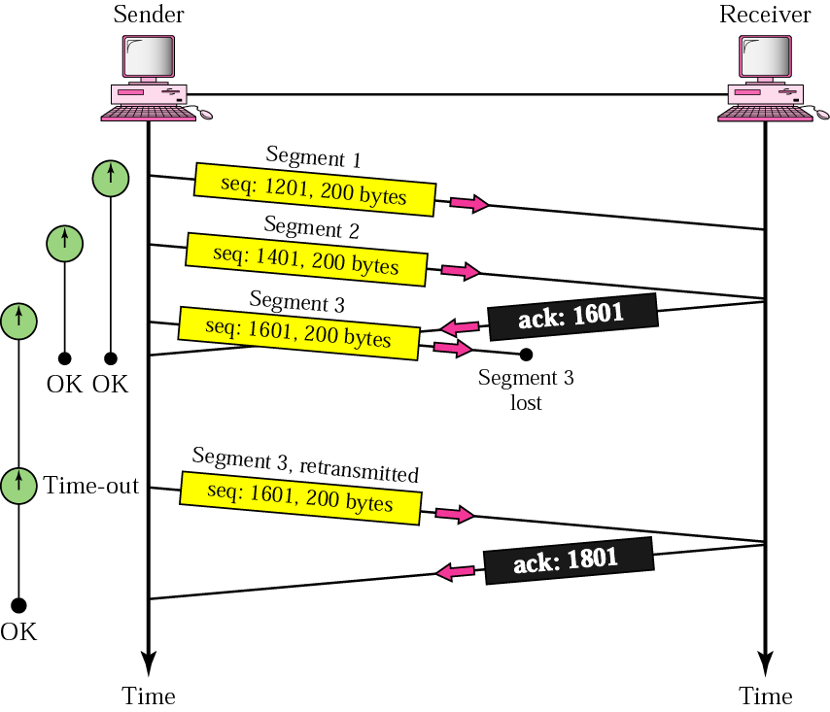
Figure 22.25 Lost segment

Slide 103
Error Control → Duplicate Segment:
A duplicate segment can be created.
E.g., by a source TCP when the acknowledgment does not arrive before the time-out.
Handling duplicate segments is a simple process for the destination TCP.
The destination TCP expects a continuous stream of bytes.
When a packet arrives that contains the same sequence number as another received segment, the destination TCP simply discards the segment.

Slide 104
Error Control → Out-of-Order Segment:
TCP uses the services of IP, an unreliable, connectionless network-layer protocol.
The TCP segment is encapsulated in an IP datagram.
Each datagram is an independent entity.
The routers are free to send each datagram through any route they may fine suitable.
so some datagram may find short route and arrive early at the destination and some may arrive late due to longer route.
If data-grams arrive out-of-order, the encapsulated TCP segments will also be out-of-order.
The handling of out-of-order TCP segments at destination is very simple.
The destination will not acknowledge any out-of-order segment until it receives all the segments preceding it.
So the acknowledgment may be delayed, if the timer of out-of-order segment matures at the source, the TCP segment may be resent.

Slide 105
Error Control → Lost Acknowledgement:
The Fig. 22.26 in next slide shows a lost acknowledgement sent by the destination.
In TCP acknowledgement mechanism, a lost acknowledgement may not even be noticed by the source TCP.
TCP uses a cumulative (increasing, collective) acknowledgment system.
Each acknowledgement is a confirmation that everything up to the byte specified by the acknowledgement number has been received.
E.g., if the destination sends an ACK segment with an ACK No for byte 1801 ,it is confirming that bytes 1201 to 1800 have been received.
If the destination has previously sent an ACK for byte 1601, meaning it has received bytes 1201 to 1600, loss of the acknowledgment is irrelevant.

Slide 106
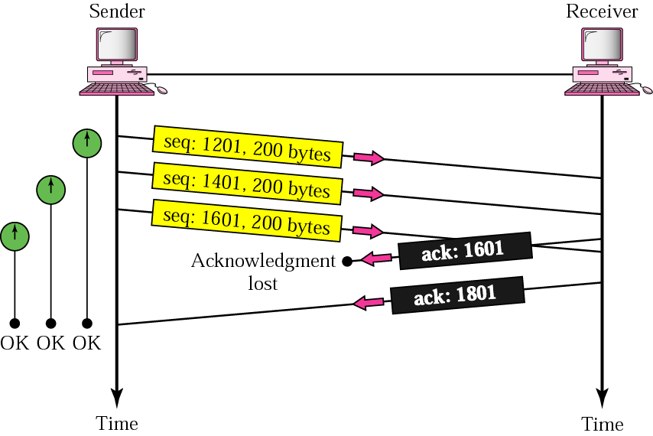
Figure 22.26 Lost acknowledgment

Slide 107
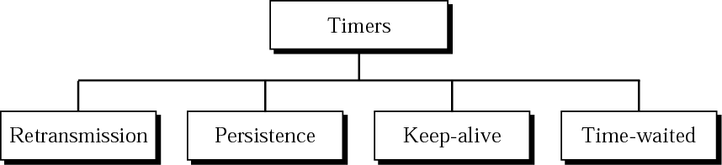
Figure 22.27 TCP timers
Fig. 22.27 below shows four timers, used by TCP to perform its operations smoothly.

Slide 108
TCP Timers → Retransmission Timer:
To control a lost or discarded segment, TCP employs a retransmission timer that handles the retransmission time, the waiting time for an acknowledgment of a segment.
When TCP sends a segment, it creates a retransmission timer for that particular segment.
Two situations may occur:
If an acknowledgement is received for this particular segment before the timer goes off, the timer is destroyed.
If the timer goes off before the acknowledgment arrives, the segment is retransmitted and timer is reset.

Slide 109
TCP Timers → Retransmission Timer → Calculation of Retransmission Time:
TCP is transport-layer protocol.
Each connection connects two TCPs that may be just one physical network apart or located on opposite sides of the globe.
Means, each connection creates a path with a length that may be totally different from another path created by another connection.
This means that TCP cannot use the same retransmission time for all connections.
Selecting a retransmission time for all connections can have serious consequences.
If the retransmission time does not allow enough time for a segment to reach the destination and an acknowledgment to reach the source, it can result in retransmission of the segments that are still on the way.
Conversely, if the retransmission time is longer than necessary for a short path, it may result in delay for the application program.

Slide 110
TCP Timers → Retransmission Timer → Calculation of Retransmission Time:
Even for one single connection, the retransmission time should not be fixed.
A connection may be able to send segments and receive acknowledgments faster during non-traffic periods and during congested periods.
TCP uses a dynamic retransmission time, a retransmission time that is different for each connection and which may change during the same connection.
Retransmission time can be made dynamic based on the round-trip time (RTT).
Several formulas care used for this purpose.
The most common is to set the retransmission time equal to twice the RTT:
Retransmission Time = 2 x RTT

Slide 111
TCP Timers → Retransmission Timer → Calculation of RTT:
The RTT is calculated dynamically.
There are two methods:
    TCP uses the value from TCP timestamp option.
    TCP sends a segment, starts a timer, and waits for an acknowledgment.
It measure the time between the sending of the segment and the receiving of the acknowledgment.
Each segment has a round trip time.
The value of the RTT used in the calculations of the retransmission time of the next segment is the update value of the RTT according to the following formula:
RTT= α (previous RTT) + ( 1 – α ) (current RTT)
The value of α is usually 90%.
This means that the new RTT is 90% of the value of the previous RTT plus 10% of the value of the current RTT.
E.g., if the previous RTT is 250 µs it takes a segment at this moment to be acknowledged in 70 µs, the value of the new RTT and the retransmission time are:
RTT = 90% x 250 + 10% x 70 = 232 µs
Retransmission time= 2 x 232 = 464 µs

Slide 112
TCP Timers → Retransmission Timer → Karn’s Algorithm:
Suppose that a segment is not acknowledged during the retransmission period and it is therefore retransmitted.
When the sending TCP receives an acknowledgment for this segment, it does not know if the acknowledgment is for the original segment or for the retransmitted one.
This problem was solved by Karn.
Karn’s solution is very simple.
  Do not consider the RTT of a retransmitted segment in the calculation of the new RTT.
  Do not update the value of RTT until you send a segment and receive an acknowledgment without the need of transmission.

Slide 113
TCP Timers → Retransmission Timer → Persistence Timer:
TCP needs another timer to deal with the zero window-size advertisement.
Suppose the receiving TCP announces a window-size of zero.
The sending TCP then stops transmitting segments until the receiving TCP sends an acknowledgment announcing a non-zero window-size.
This ACK can be lost.
(Acknowledgements are not acknowledged in TCP)
If the ACK is lost, the receiving TCP thinks that it has done its job and waits for the sending TCP to send more segments.
The sending TCP has not received the ACK and waits for the destination TCP o send an ACK advertising the size of the window.
Thus both TCPs continues to wait for each other forever.

Slide 114
TCP Timers → Retransmission Timer → Persistence Timer:
To correct this deadlock, TCP uses a persistence timer for each connection.
When the sending TCP receives an ACK with the window size of zero, it starts a persistence timer.
When the persistence timer goes off, the sending TCP sends a special segment called a probe.
This segment contains 1 Byte of data
It has a sequence number, but this sequence number is never acknowledged and even also not included in calculating the sequence number for the rest of data.
The probe alerts the receiving TCP that acknowledgment was lost and should be resent.
The value of the persistence timer is set to the value of the retransmission time.
However, if a response is not received from the receiver, another probe is sent and the value of the persistence timer is doubled and reset.
The sender continues sending the probe segments and doubling the value of the persistence timer until the value reaches a threshold (usually 60s).
After that, the sender sends one probe every 60s until the window is reopened.

Slide 115
TCP Timers → Retransmission Timer → Keep-Alive Timer:
A keep-alive-timer is used in some implementations to prevent a long idle connection between two PCs.
Suppose that a client opens a TCP connection to a server, transfers some data and becomes silent.
Perhaps the client has crashed.
In this case, the connection remains open for-ever.
To remedy this situation. Most implementations equip a server with a keep-alive timer.
Each time server hears a client, it resets the timer.
The time-out is usually 2h.
If the server does not hear from the client after 2h, it sends a probe segment.
If there is no response after 10probs, each of which is 7s apart it assumes that the client is down and terminates the connection.

Slide 116
TCP Timers → Retransmission Timer → Time-Waited Timer:
Time-waited Timer is used during the connection termination.
When TCP closes a connection, it does not consider the connection to be really closed.
The connection is held in indeterminate state for a time-waited period.
This allows duplicate FIN segments, if any, to arrive at the destination to be discarded.
The value for this timer is usually 2 times the expected lifetime of the segment.

Slide 117
Congestion Control and other features:
Congestion control:
Congestion control in TCP will be discussed later.
Other Features:
There are two other features that need to be discussed:
    Pushing data and
    Handling urgent data.

Slide 118
TCP Features →Pushing Data:
The sending TCP uses a buffer to store the stream of data coming from the sending application program.
The sending TCP can choose the size of the segments.
The receiving TCP also buffers the data when they arrive and delivers them to the application program when application program is ready or when the receiving TCP feels that it is convenient.
This type of flexibility increases the efficiency of TCP.
However, there are occasions in which the application program is not comfortable with this flexibility.
E.g., consider an application program that communicates interactively with another application program on the other end.
This application program on one side wants to send keystroke to the application program at the other side and receive an immediate response.
Delayed transmission and delayed delivery of data may not be acceptable to the application program.

Slide 119
TCP Features →Pushing Data:
TCP can handle such situation.
The application program on the sending side can request a push operation.
This means that the sending TCP should not wait for the window to be filled.
It must create a segment and send it immediately.
The sending TCP can also set the push bit (PSH) to tell the receiving TCP that the segment includes data that must be delivered to the receiving application program as soon as possible and not to wait for more data to come.
Although the push operation can be requested by the application program, today most implementations ignore such requests.
TCP can choose whether to use this operation.

Slide 120
TCP Features →Urgent Data:
TCP is stream-oriented protocol.
This means that the data are present from application program to TCP as stream of characters.
Each byte of data has a position in stream.
However, there are occasions in which an application program needs to send urgent bytes.
This means that the sending application program wants a piece of data to be read out of order by the receiving application program.
Supposed that the sending application program is sending data to be processes by receiving application program.
When the result of the processing comes back, the sender application program finds everything is wrong.
It wants to abort the process, but it has already sent a huge amount of data.
If it issues an abort command (Ctrl+C), these characters will be stores at the end of the receiving TCP buffer.
It will be delivered to the receiving application program after all the data have been processed.

Slide 121
TCP Features →Urgent Data:
The solution is to send a segment with the URG bit set.
The sending application program tells the sending TCP that the piece of data is urgent.
The sending TCP creates a segment and inserts the urgent data from the buffer.
The urgent pointer field in the header defines the end of the urgent data and the start of the normal data.
When the receiving TCP receives a segment with URG bit set, it extracts the urgent data from the segment, using the value of the urgent pointer, and delivers it, out-of-order, to the receiving application program.

Slide 122
Additional information about PORTS
That blue or green network cable coming out of your computer/modem/router is actually a busy highway comprised of 65,536 tiny electronic lanes
(yes, over sixty-five thousand little lanes for your electrons).
Each lane is called a "port", and each port is designed to allow only specific types of information through.
Many ports are assigned in a semi-standardized way. Here are some example port assignments:
HTML pages: port 80
FTP file transferring: port 21
World of Warcraft: port 3724
POP3 email: port 110
MSN Messenger: port 6901 and ports 6891-6900
Everquest: port 1024
Bit Torrents: port 6881

Slide 123
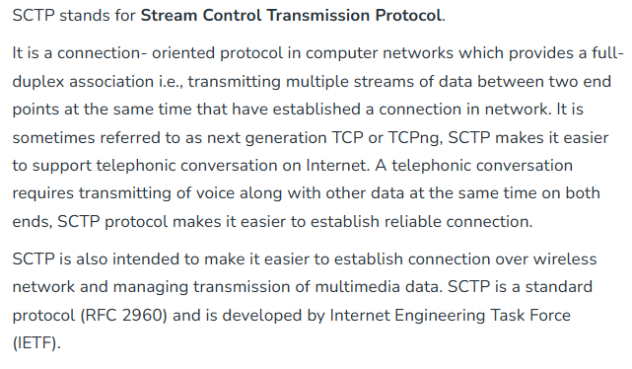

Slide 124
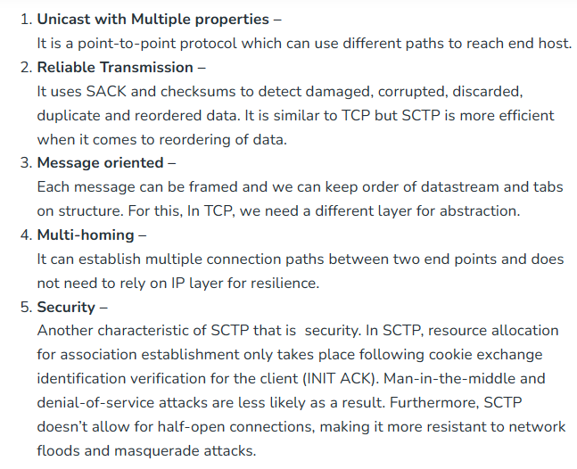
Characteristics

Slide 125
